Slide 1
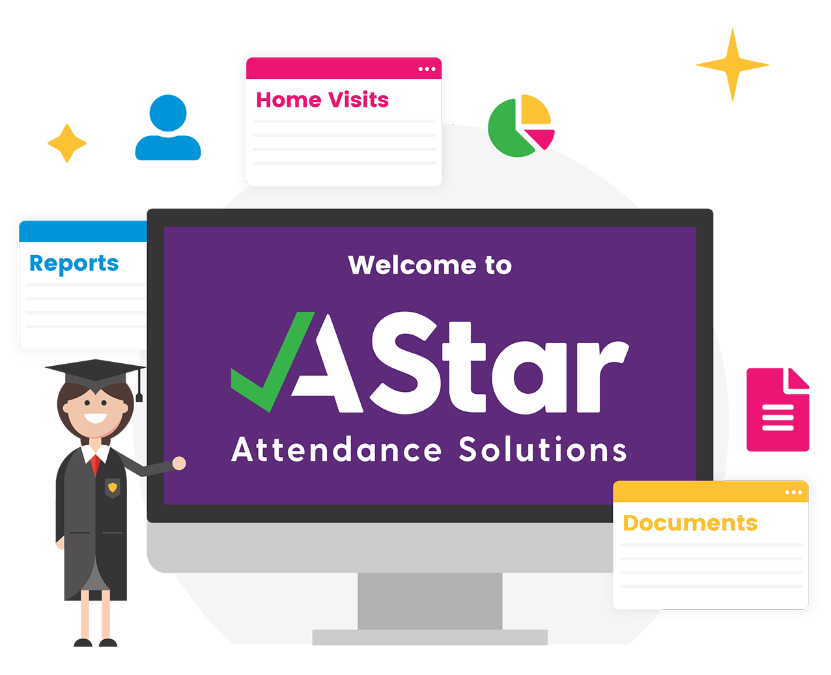
Attendance Competition

Slide 2
School Attendance Matters…Why?
You have a right to an education.
Any absence and regular patterns of absence can affect your learning.
Catching up on missed work can be very difficult and frustrating.
The best place for you to be is with your teacher supporting your education.
You need to be in school every day!

Slide 3
What does good attendance mean for you?
Every Lesson Counts!
You establish good behaviour patterns and routines.
You have more opportunities to make friends and socialise.
You have better chance of being successful in your adult life.

Slide 4
The greater your attendance the greater you achieve!
With 90% or less attendance you are classed as being persistently absent.
You have missed on average ½ a day each week.
This is the same as 4 weeks a year!
This could affect your grades.

Slide 5
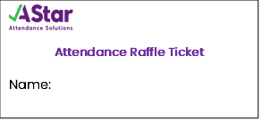
Weekly Raffle
To get a weekly raffle ticket you need to have 100% attendance for that week.
Write your name and class on your raffle ticket and put it into the raffle box.
At the end of the half term the raffle is drawn and the name picked from the box wins!
You’ve got to be in to win!

Slide 6
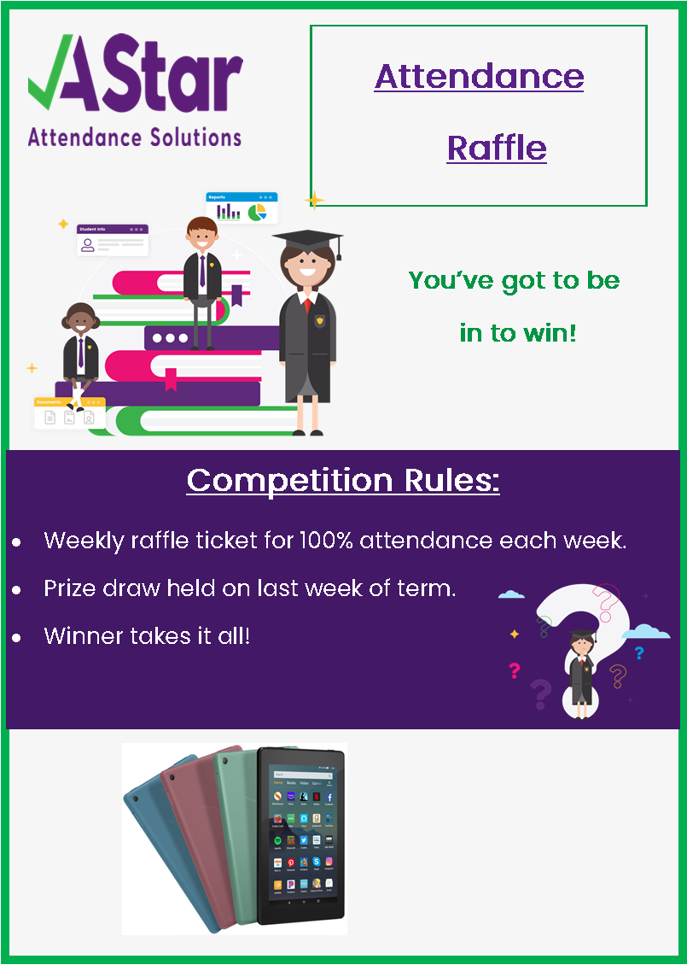
PRIZE

